Slide 1
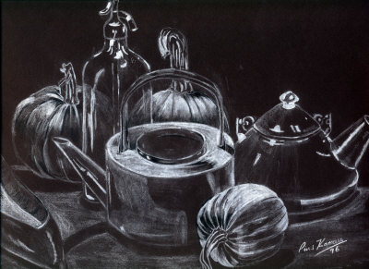
Chiaroscuro Still Life
Black paper drawing using white medium

Slide 2
Time Period: Renaissance
Cultural movement that began in Italy in the 14th Century. It eventually spread throughout Europe.
Its influence affected literature, philosophy, art, politics, science, religion, and more
Searched for realism and human emotion in art
Artists were the “celebrities” hired by government to create artwork as permanent installations
Hired to paint or sculpt as a career or life long calling (usually did both along with writing)

Slide 3
Artists names to know
It was not uncommon for artists to share a common last name, but different first name.
Michelangelo Buonarroti (Sistine Chapel, David)
Fillipo Brunilleschi
Leonardo da Vinci (human anatomy)
Titian
Donatello (Ninja Turtles)
Raphael
Jan Van Eyck (Netherlands)
Rembrandt van Rijn
Michelangelo Merisi da Caravaggio

Slide 4
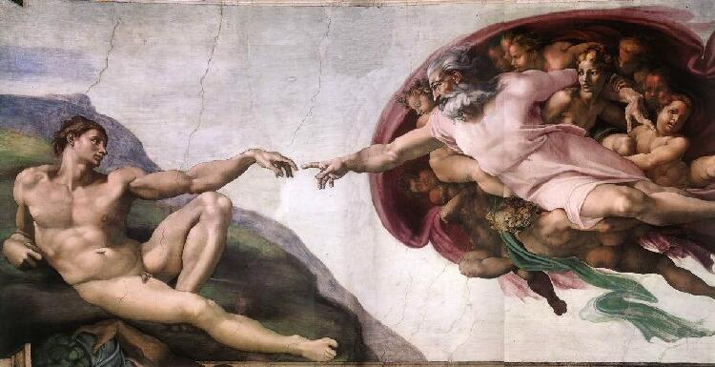
Example Renaissance work
The Creation of Adam by Michelangelo (Sistine Chapel)

Slide 5
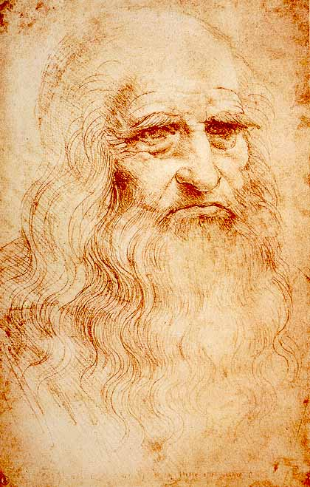
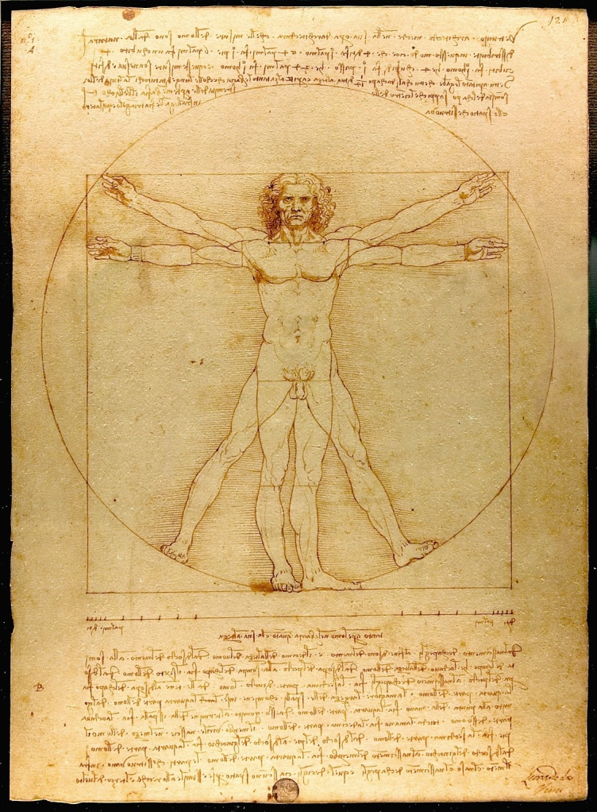
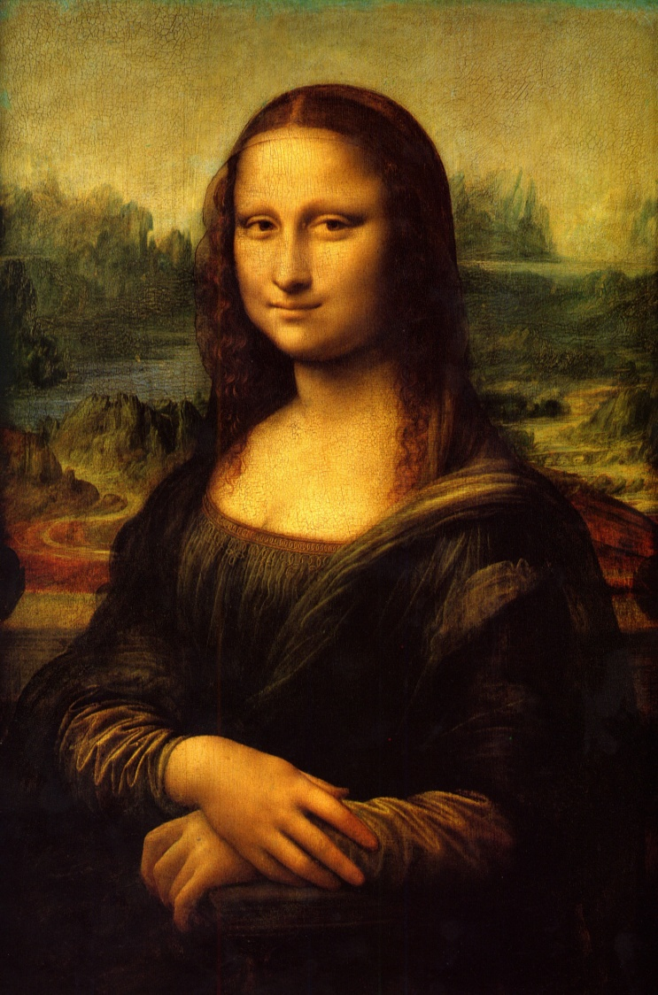
Leonardo Da Vinci
Self Portrait Drawing
Vitruvian Man-Anatomy
Mona Lisa Painting

Slide 6
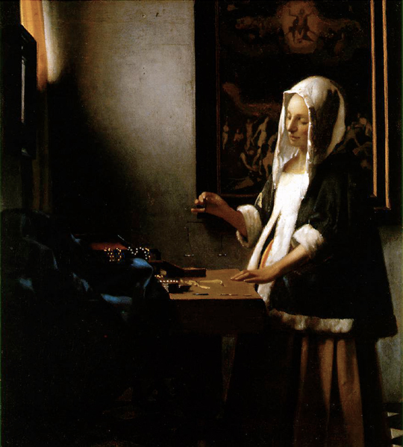
Woman Holding a Balance
By Jan Vermeer, 1664

Slide 7
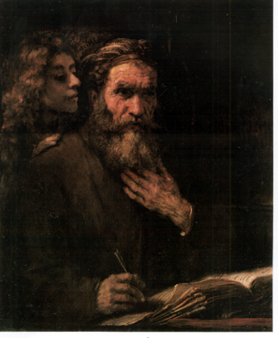
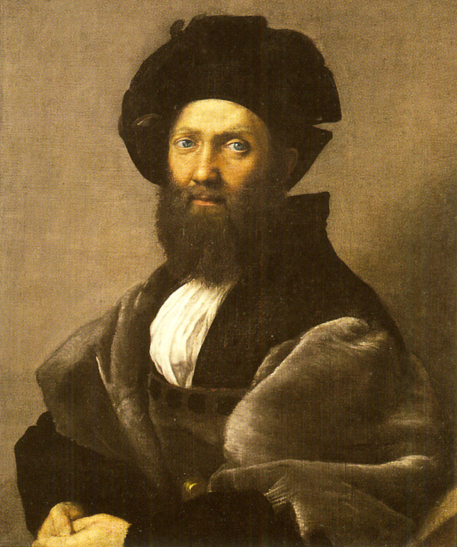
Saint Matthew and Angel
by Rembrandt van Rijn, 1661
Castiglione
by Raphael, 1514-1515

Slide 8
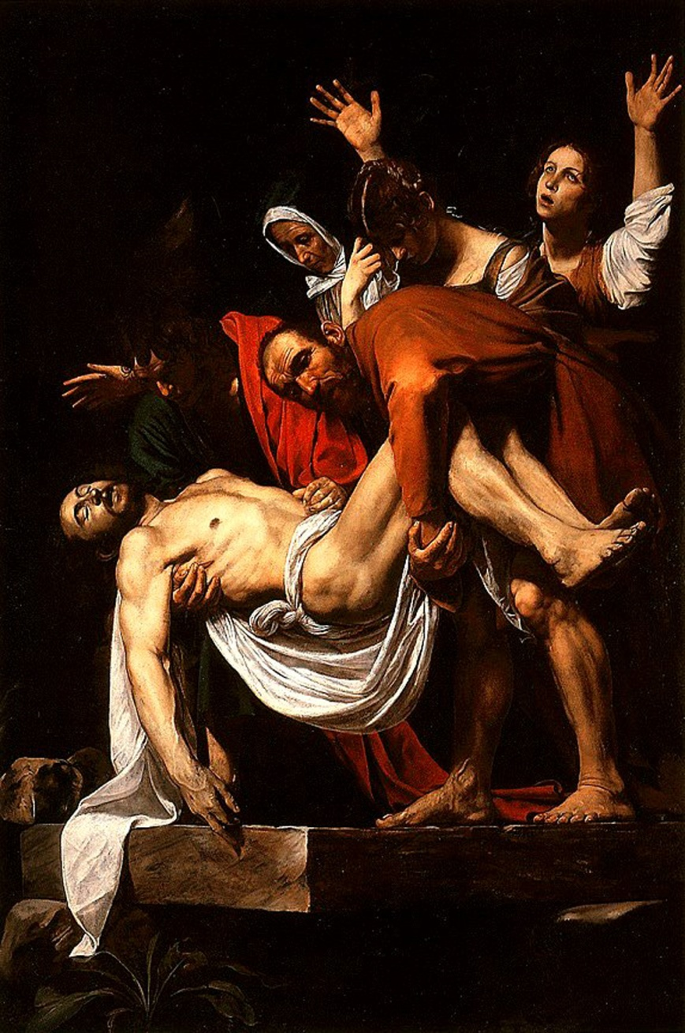
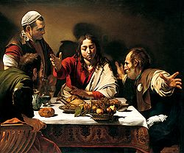
The Entombment of Christ
By Michelangelo Caravaggio , 1602-1603
Supper at Emmaus
By Michelangelo Caravaggio , 1601

Slide 9
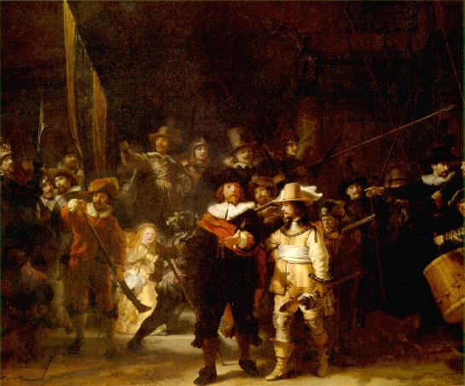
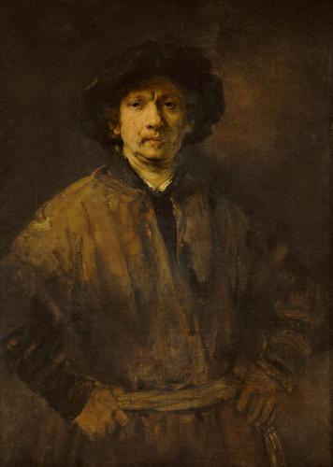
The Night Watch
by Rembrandt van Rijn , 1642
Self Portrait
by Rembrandt van Rijn , 1652

Slide 10
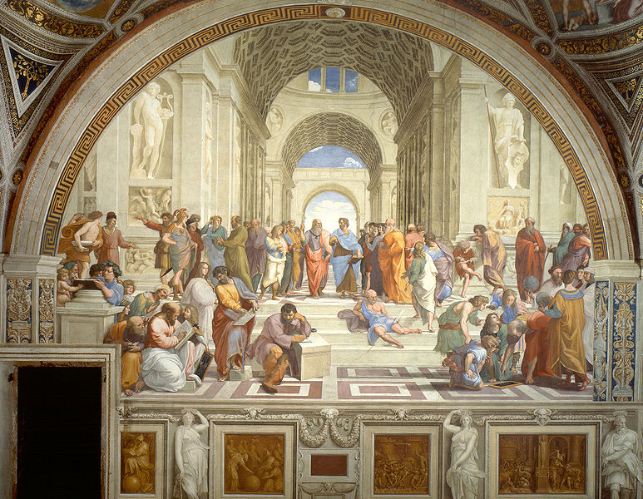
The School of Athens Fresco by Raphaello Sanzio , 1510-1511

Slide 11
Refresh Elements and Principles
Line (thin, thick, curved, straight)
Shape (geometric, organic, flat)
Value (high and low key, shading, gradation)
Color (primary, secondary, neutral, black)
Texture (simulated and invented)
Form (around a shape, volume)
Space (foreground, middle and background)

Slide 12
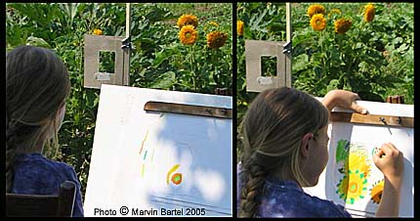
Using a viewfinder

Slide 13
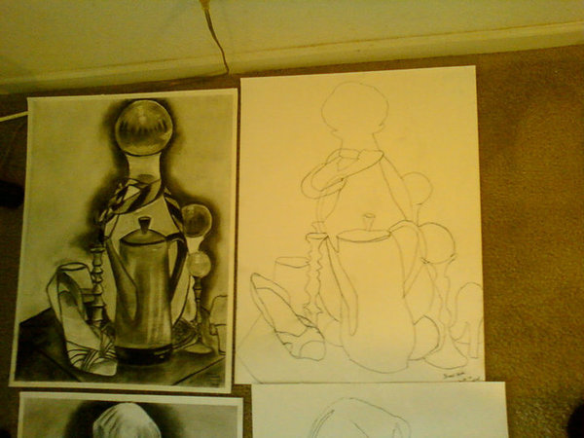
Semi-Blind Drawing
Pencil to the paper constantly
Continuous drawing of subject
Looking at the object
Glancing at the paper

Slide 14
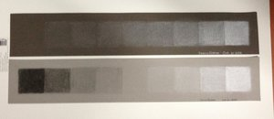
Value Scale
Range of Values

Slide 15
Things to know
View finder to pick composition
Remember high, middle and low placement
Horizontal and vertical paper direction
Standing versus sitting
Rule of thirds
Use of materials-holding pencil, eraser, paper towel or blending stump
Looking for values, shapes, lines, etc.
Begin with thumbnails and sketches

Slide 16
Thumbnails (10-12) and Sketches (4)
1. Rough and without detail
Use shapes mainly
Fast and loose
2. Rough, but slight detail
Add in items from view
Horizontal and vertical
LAST STEP: Larger drawing using newsprint

Slide 17
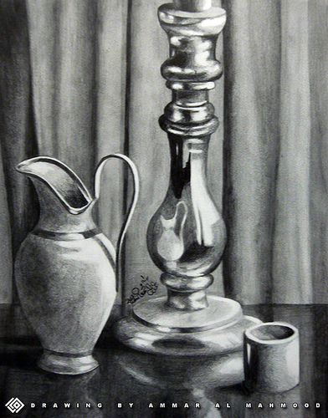
Example still life drawings

Slide 18
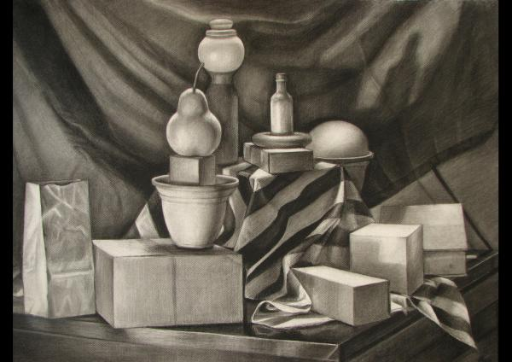

Slide 19
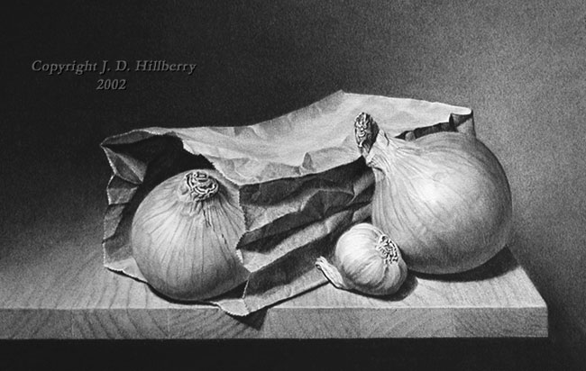

Slide 20
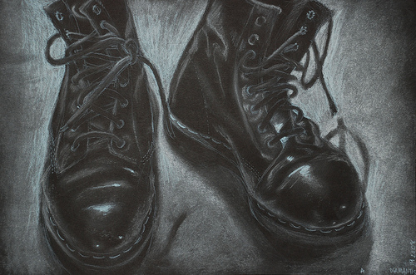
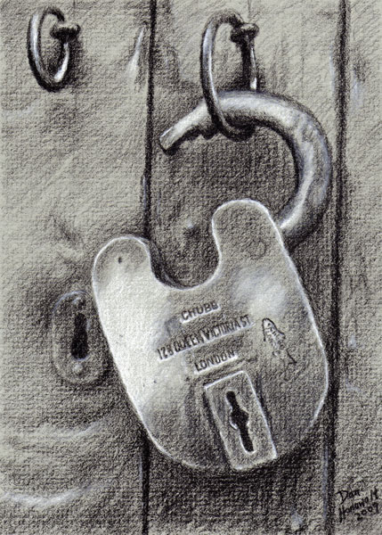
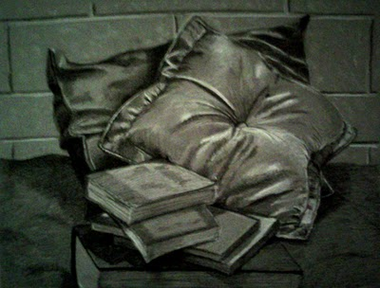

Slide 21
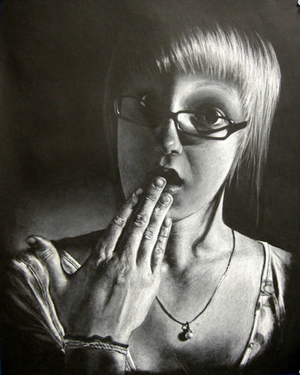

Slide 22
http://www.students.sbc.edu/kitchin04/artandexpression/renaissance%20art.html

